Slide 1

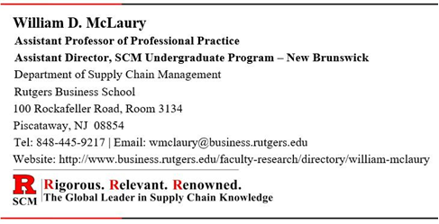
Supply Chain
Management
Forecasting and Demand Planning

Slide 2
Mastering the Supply Chain: How Planning Ensures Products Are Always Available - YouTube

Slide 3
Forecasting and Demand Planning
Forecasting and Demand Planning are the key building blocks from which all supply chain planning activities are derived.
The first step is Forecasting, where the forecast is developed through data analysis and judgement.
  Organizations must have a formal forecasting process to develop an agreed upon set of numbers that becomes the driver for demand planning.
  The second step is Demand Planning where management and other experts within the company review the forecast to ensure that it is aligned with the company’s strategy, business policies, and business knowledge, and make adjustments if necessary.
Forecasting and Demand Planning are crucial components of customer satisfaction.

Slide 4

Key Terms
Forecast is an estimate of future demand.
Forecasting is the business function that estimates future demand for products so that they can be purchased or manufactured in appropriate quantities in advance of need.
Demand is the need for a particular product or component. The demand could come from various sources such as a customer order, a forecast, the manufacturing of another product, etc.
Demand Planning is the process of combining statistical forecasting techniques and judgment to construct demand estimates for products or services.

Slide 5
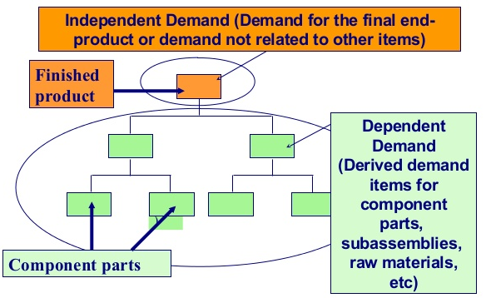
Key Terms (continued)
Independent Demand is demand for an item that is unrelated to the demand for other items, such as a finished product, a spare part, or a service part. [Demand for these items is Forecasted]
Dependent Demand is demand for an item that is directly related to other items or finished products, such as a component or material used in making a finished product. [Demand for these items is Calculated]
Example:
Finished Product = Bicycle [Independent Demand Item]
Component Parts = Frame, Seat, Handle Bar, Wheels, Tires, Pedals, etc. [Dependent Demand Items]

Slide 6


Forecasting
There are two important considerations about a forecast:
Statistically speaking, the forecast will be inaccurate (“wrong”). Although it may be inaccurate, it is still useful.
The forecast is the basis for most “downstream” supply chain planning decisions.
    Good forecasting can benefit a company by facilitating more effective planning, which can lead to reduced inventories, reduced costs, reduced stockouts, and improved customer service.
    Bad forecasting can be the root cause for creating just the opposite. There is a familiar adage that applies to forecasting: “garbage in = garbage out.” If a forecast is bad, everything else (i.e., the supply plan) based on that forecast will also be bad.
Companies spend a lot of time and effort trying to figure out how they can best forecast because that will make everything else downstream flow more smoothly.

Slide 7

Forecasting Techniques
There are two basic forecasting techniques used in most businesses today.
Qualitative forecasting which is based on opinion and intuition.
Quantitative forecasting which uses mathematical models and historical data to make forecasts.

Slide 8

Forecasting Techniques (continued)
There are two theories to getting an accurate forecast.
Neither one works.
Since a forecast is an estimate of future demand, and is likely to be inaccurate, the goal of the forecasting and demand planning process is to minimize forecast error
The factors that influence demand must also be considered when forecasting, e.g., market changes, seasonality, competitive activity, etc.

Slide 9
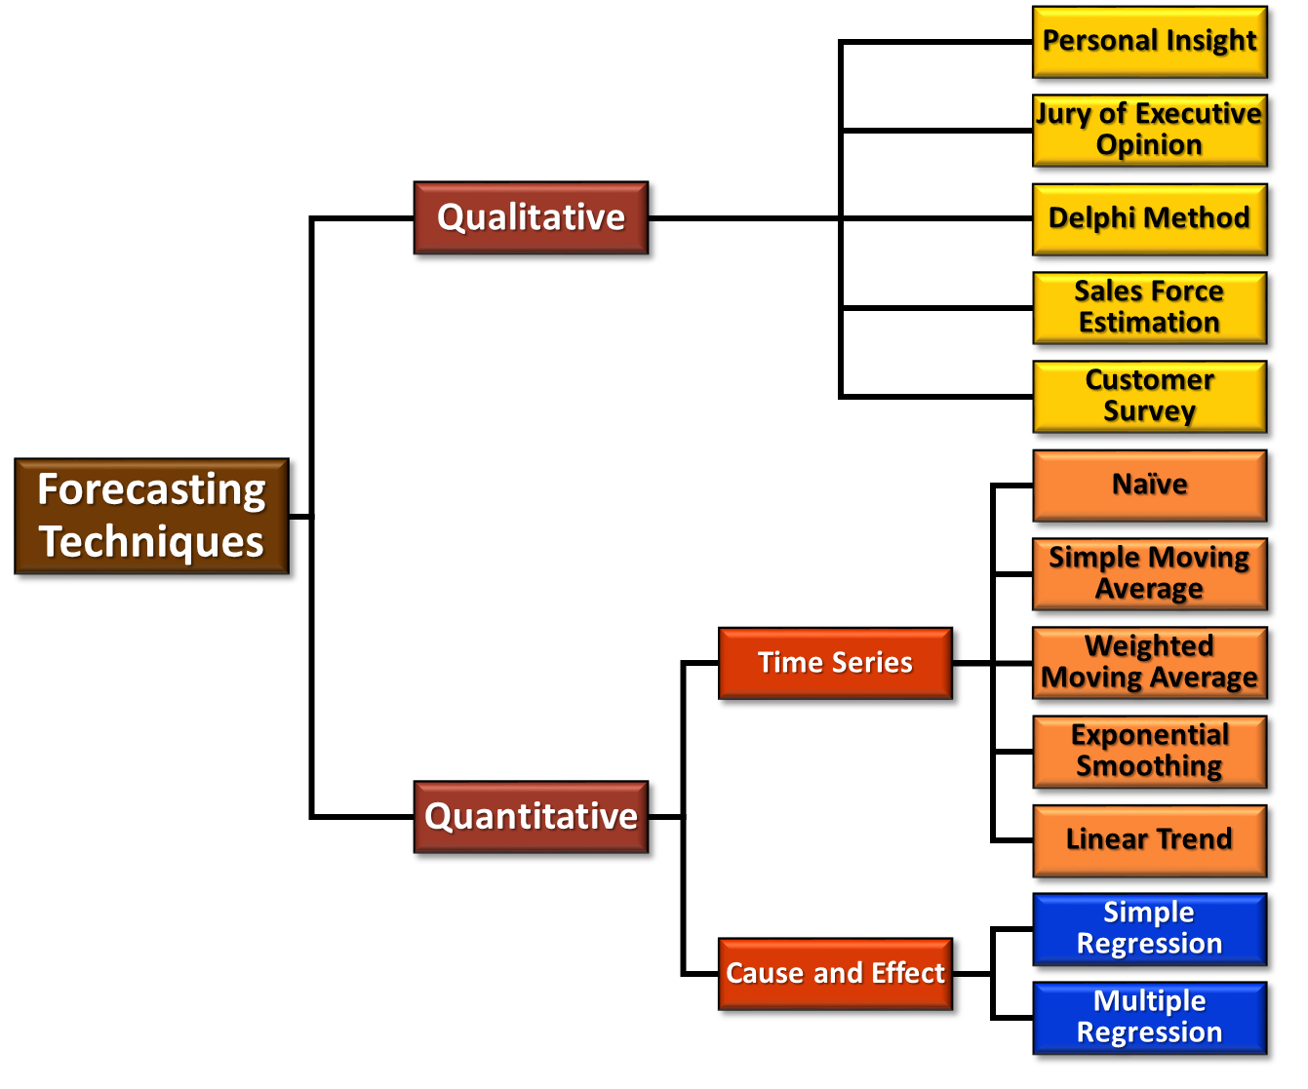
Forecasting Techniques (continued)

Slide 10
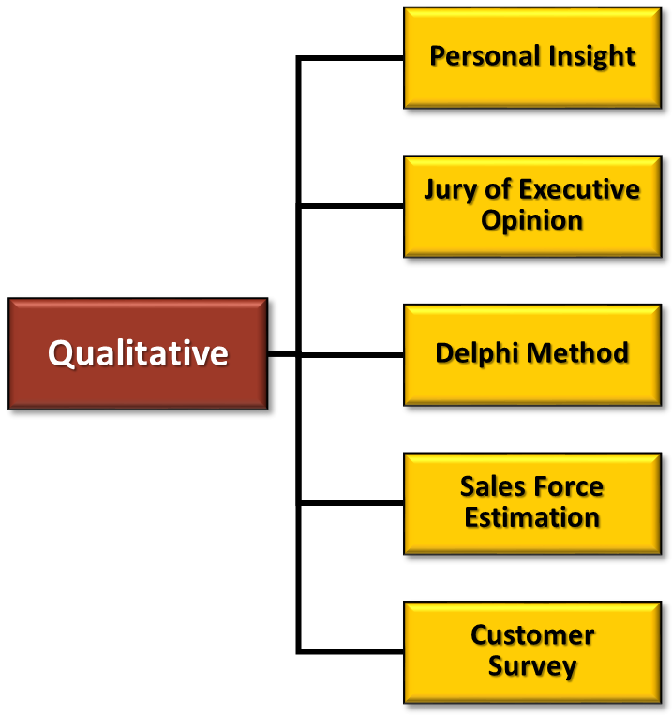
Qualitative Forecasting Techniques
Qualitative forecasting - based on opinion and intuition.
  Generally used when data are limited, unavailable, or not currently relevant. Examples: new product, new market segment
  Forecast depends on skill and experience of forecaster(s) and available information
  The five qualitative models used are:
  Personal Insight
  Jury of Executive Opinion
  Delphi Method
  Sales Force Estimation
  Customer Survey

Slide 11
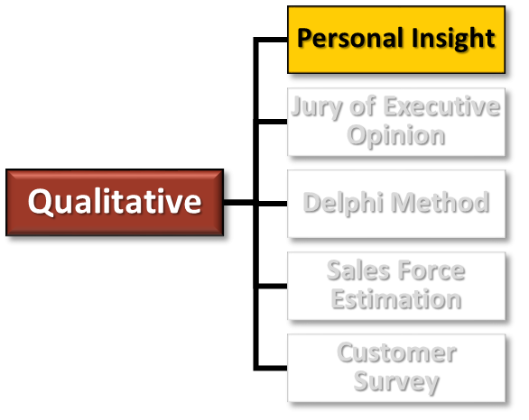
Qualitative Forecasting - Personal Insight
Personal Insight: The forecast is based on the insight of the most experienced, most knowledgeable, or most senior person available.
  Sometimes, this approach is the only option, but methods that include more people are generally more reliable.
    Advantages:
    It is the fastest and cheapest forecasting technique.
    It can provide a good forecast.
    Disadvantages:
    It relies on one person’s judgement and opinions, but also on their prejudices and ignorance.
    The major weakness is unreliability; someone who is familiar with the situation often provides a worse forecast than someone who knows nothing.

Slide 12
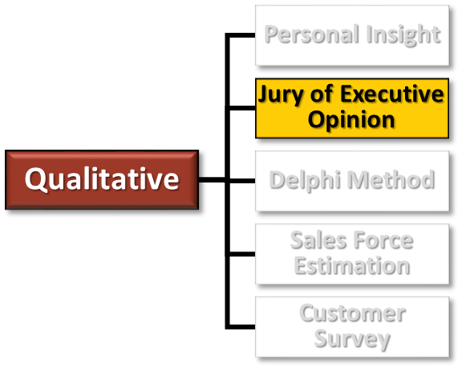
Qualitative Forecasting - Jury of Executive Opinion
Jury of Executive Opinion: People who know the most about the product and the marketplace would likely form a jury (i.e., management panel) to discuss and determine the forecast.
Generally, the panel conducts a series of forecasting meetings to discuss the forecast until the panel reaches a consensus agreement.
  Advantages:
  Decisions are enriched by the experience of competent experts.
  Companies don’t have to spend time and resources collecting data by survey.
  Disadvantages:
  Experts may introduce some bias.
  Experts may become biased by their colleagues or a strongly opinionated leader.

Slide 13
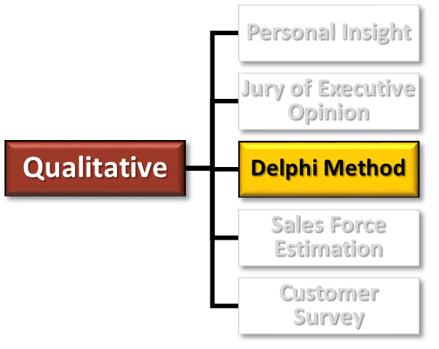
Qualitative Forecasting - Delphi Method
Delphi Method: Basically the same as the Jury of Executive Opinion except that the input of each of the participants is collected separately so that people are not influenced by one another.
This is done in several rounds until a consensus forecast is achieved.
  Advantages:
  Decisions are enriched by the experience of competent experts.
  Decisions are not likely a product of groupthink.
  Very useful for new products
  Disadvantages:
  Experts may introduce some bias.
  Companies must spend time & resources collecting data by survey.
  If external experts are used there is a risk of loss of confidential information.
  The Delphi Method can be time-consuming and is therefore best for long-term forecasts.

Slide 14
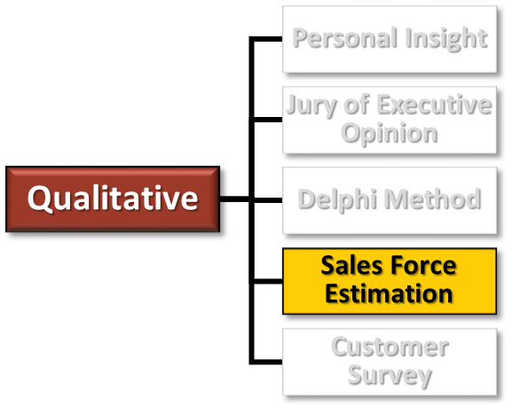
Qualitative Forecasting - Sales Force Estimation
Sales Force Estimation: Basically the same as the Jury of Executive Opinion except that it is performed specifically with a group of sales people.
Individuals working in the sales function bring special expertise to forecasting because they maintain the closest contact with customers.
  Advantages:
  No additional cost to collect data because internal sales people are used.
  More reliable forecast as it is based on the opinions of salespersons in direct contact with the customer.
  Disadvantages:
  Not ideal for long term forecasting
  Salespersons may introduce some bias

Slide 15
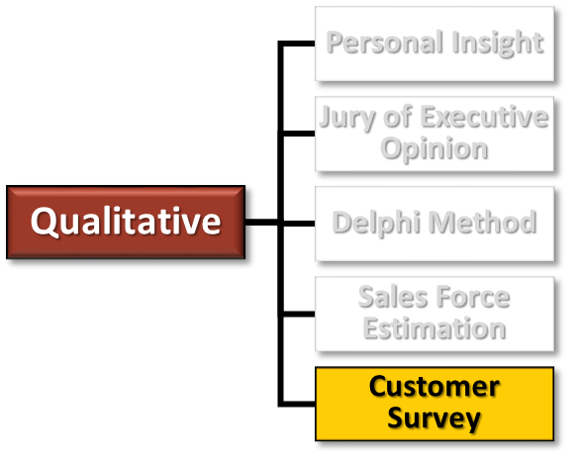
Qualitative Forecasting - Customer Survey
Customer Survey: Customers are directly approached and asked to give their opinions about the particular product.
Customer surveys can be done in person (e.g., one-on-one, focus group), over the phone, by mail, email, or online.
  Advantages:
  It is a direct method of assessing information from the primary sources.
  Simple to administer and comprehend.
  It does not introduce any bias or value judgment particularly in the census method if the questions are constructed carefully.
  Disadvantages:
  Poorly formed questions may lead to unreliable information.
  Customers do not always answer the questionnaire.
  It is time consuming and costly to survey a large population.

Slide 16
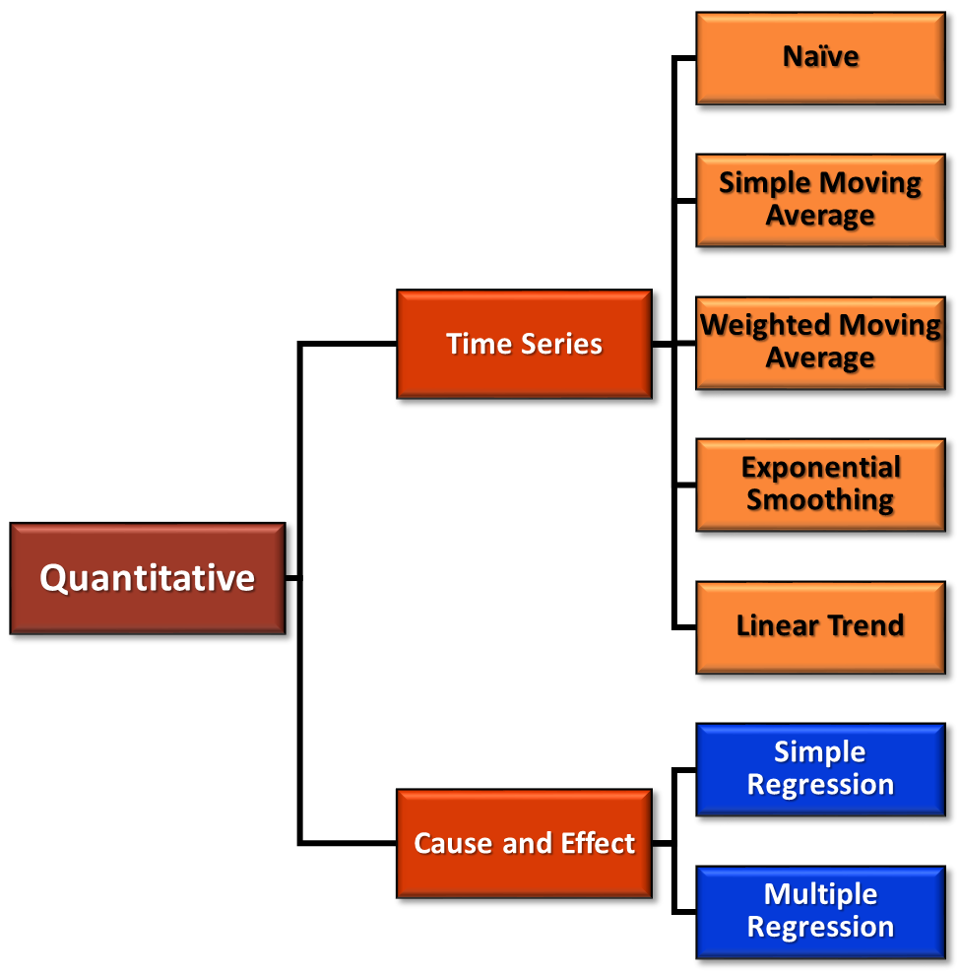
Quantitative Forecasting Techniques
Quantitative forecasting uses mathematical models and historical data to make forecasts
  Time Series – based on the assumption that the future is an extension of the past. Historical data is used to predict future demand
    The most frequently used among all the forecasting models.
  Cause and Effect – assumes that one or more factors (independent variables) predict future demand (e.g., seasonality in retail markets)
It is generally recommended to use a combination of quantitative and qualitative techniques

Slide 17
Variations in Quantitative Forecasting
When creating a quantitative forecast, data should be evaluated to detect for the following components:
  Trend Variations: Movement of a variable over time. Might be more easily observed by plotting actual demand on a graph over time to see whether there is an increase or decrease. (e.g., laptops, cell phones, fashion products, toys)
  Random Variations: Instability in the data caused by random occurrences. These random changes are generally very short-term, and can be caused by unexpected or unpredictable events such as weather emergencies, natural disasters, etc. (e.g., hurricane = wood for roof repair, tree clean up, water damage)
  Seasonal Variations: Repeating pattern of demand from year to year, or over some other time interval, with some periods of considerably higher demand than others (e.g., holiday shopping, restaurant customers, swim suits sales by region, building construction slowing in winter by region)
  Cyclical Variations: a wavelike pattern that can extend over multiple years, and therefore, cannot be easily predicted. (e.g., business cycle, China growth, GDP, bull or bear markets)

Slide 18
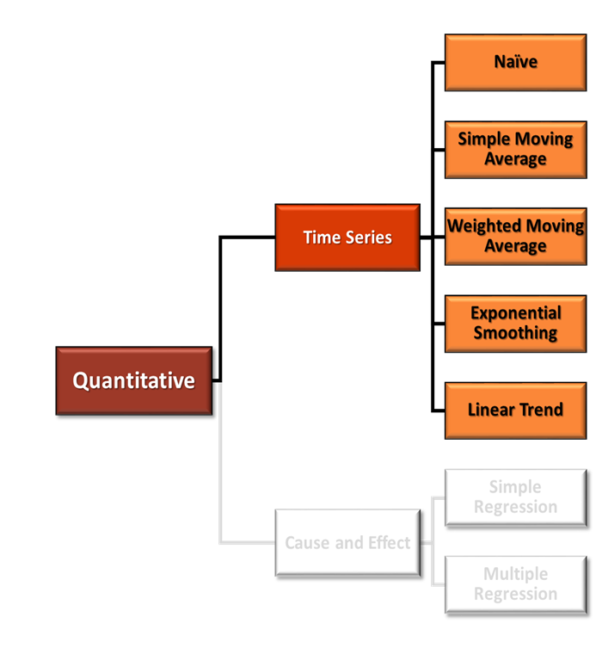
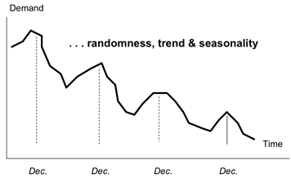
Time Series Forecasting
The main purpose of a time series model is to collect and study the past data of a given time series in order to generate probable future values for the series.
In other words, forecasts for future demand rely on understanding past demand.
Accordingly, time series forecasting can be characterized as the act of predicting the future by understanding the past

Slide 19
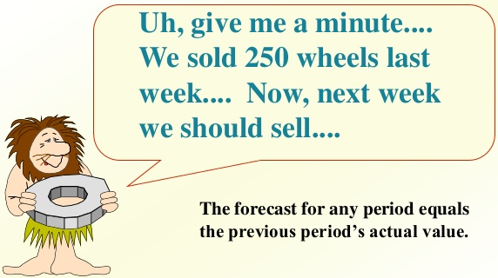
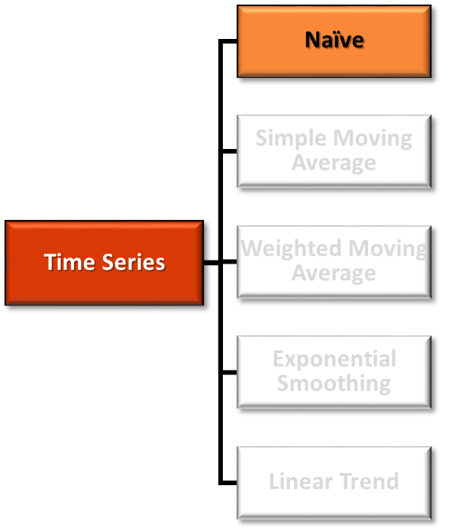
Time Series - Naïve Forecasting
  Naïve Forecasting – Sets the demand for the next time period to be exactly the same as the demand in the last time period.
  Advantages: Works well for mature products and is very easy to determine.
  Disadvantages: Works for mature products only. Any variations in demand will create inventory issues.

Slide 20
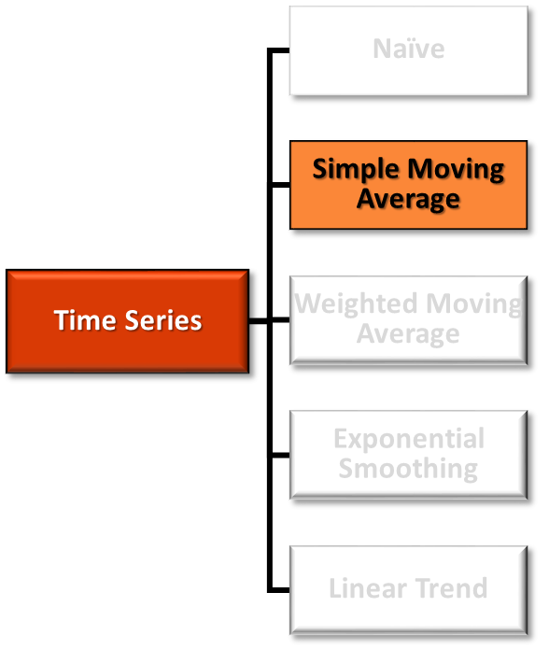
Time Series - Simple Moving Average Forecasting
  Simple Moving Average – Uses a calculated average of historical demand during a specified number of the most recent time periods to generate the forecast.
  Advantage: Provides a very consistent demand over long periods of time and smooths out random variations.
  Disadvantage: Fails to identify trends or seasonal effects.
  It will also create shortages when demand is increasing because it lags behind actual demand.
EXAMPLE: 4 months history

Slide 21
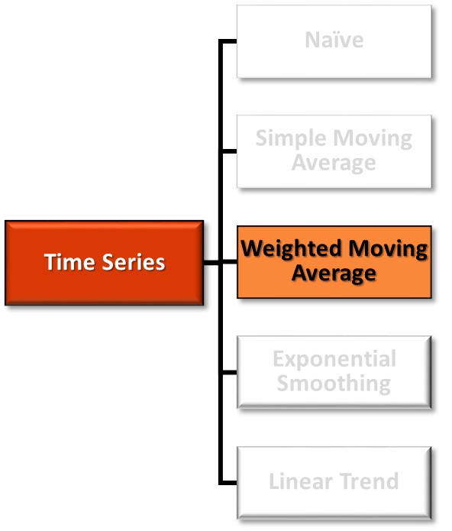
Time Series - Weighted Moving Average Forecasting
  Weighted Moving Average – similar to a simple moving average except that not all historical time periods are valued equally.
  Advantage: More accurate than a simple moving average if actual demand is increasing or decreasing.
  Disadvantage: Though better than a simple moving average, this technique will still lag behind actual demand to some degree.
EXAMPLE: 4 months history
  The challenging part of using a weighted moving average is deciding on the weight for each time period.

Slide 22
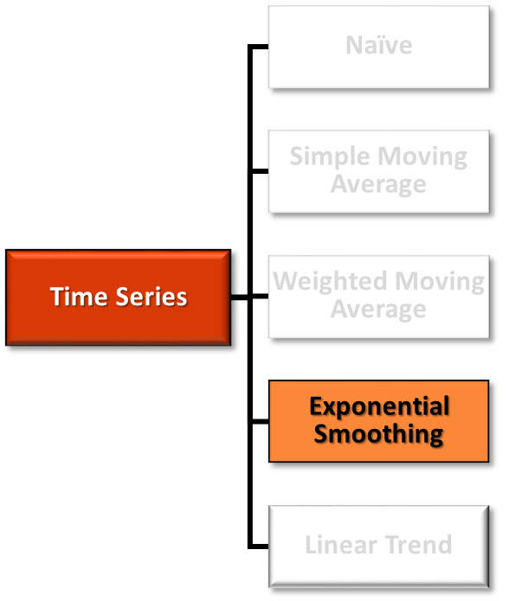
Time Series - Exponential Smoothing
  Exponential Smoothing – is a more sophisticated version of the weighted moving average. Requires 3 basic elements: last period’s forecast, last period’s actual demand, and a smoothing factor, which is a number greater than 0 and less than 1 (used as a weighting percentage).
  Advantage: Exponential smoothing will create a forecast more responsive to trends than previous methods.
  Disadvantage: Exponential smoothing will still lag behind trends, especially upward trends since the smoothing factor would need to be greater than 1.0 to approach an accurate forecast.
The smoothing constant is not a given. It has to be determined based on the best judgment of a company’s experts.

Slide 23
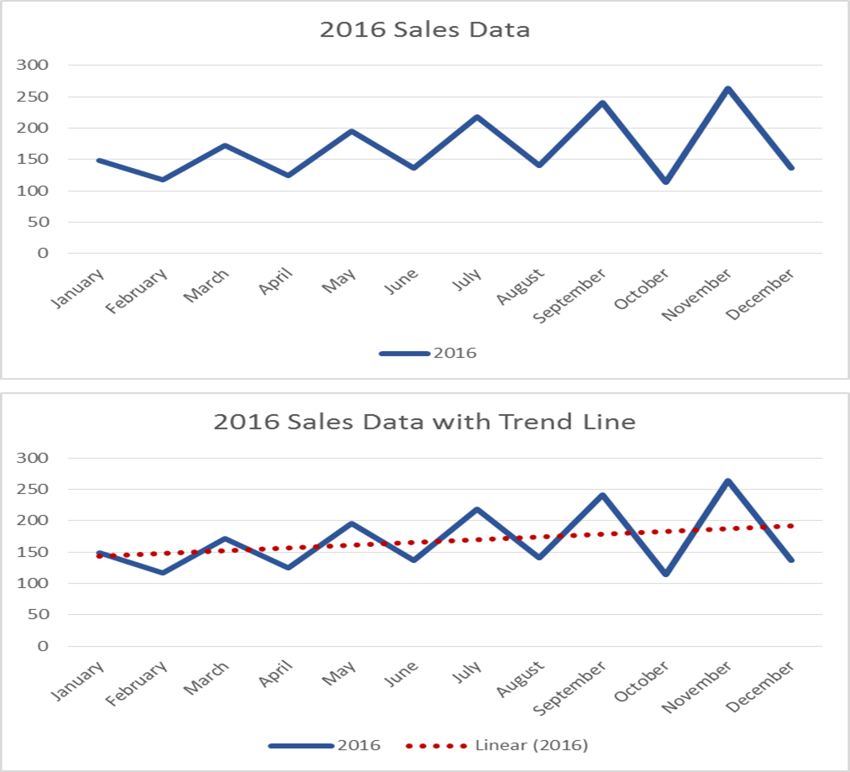
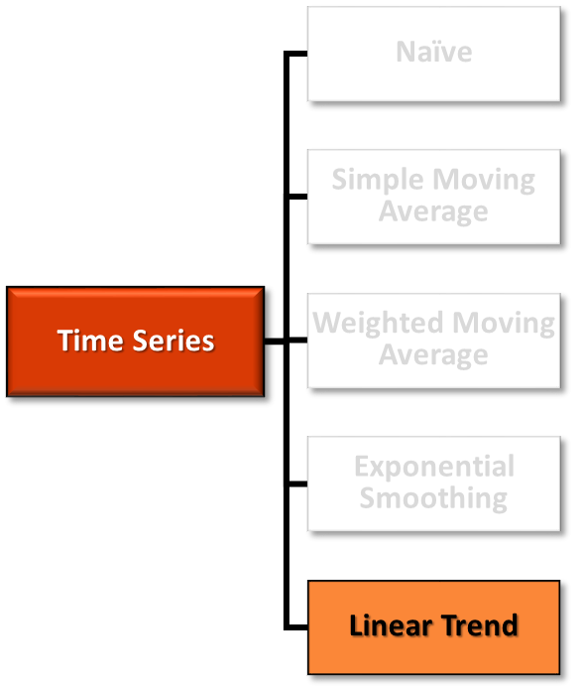
Time Series - Linear Trend Forecasting
  Linear Trend Forecasting – is imposing a best fit line across the demand data of an entire time series. Used as the basis for forecasting future values by extending the line past the existing data and out into the future while maintaining the slope of the line.
  Advantage: can provide an accurate forecast into the future even if there is random variation.
  Disadvantage: seasonal and cyclical variations are softened, making this method more useful for annual forecasts than for monthly forecasts.

Slide 24
Forecasting Techniques (continued)

Slide 25
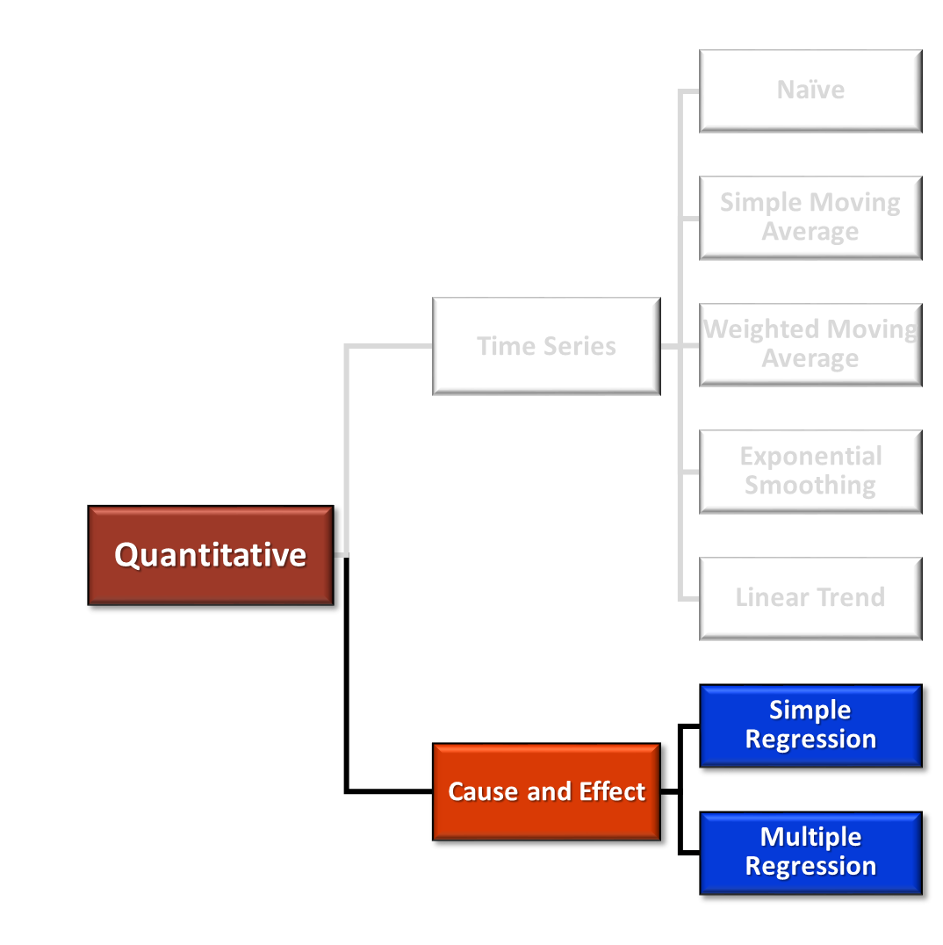

Cause and Effect Forecasting
There are two basic cause-and-effect models:
Simple Linear Regression
Multiple Linear Regression
Regression uses the historical relationship between an independent and a dependent variable to predict the future values of the dependent variable, i.e., demand

Slide 26
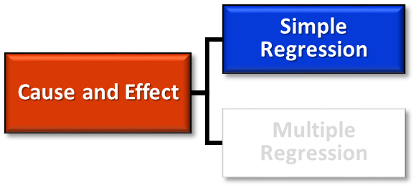
Cause and Effect - Simple Linear Regression
  Simple Linear Regression attempts to model the relationship between a single independent variable and a dependent variable (demand) by fitting a linear equation to the observed data.
  The equation describes the relationship between the independent variable and dependent variable as a straight line.
  For example, the demand might be dependent on how much money is spent on advertising and promotion: the more money spent, the higher the demand.
  The line that represents this relationship can be used to forecast demand with consideration of future values of the independent variable.
  In other words, if a company plans on investing more in advertising, it might be necessary to increase the forecast, or vice versa.

Slide 27
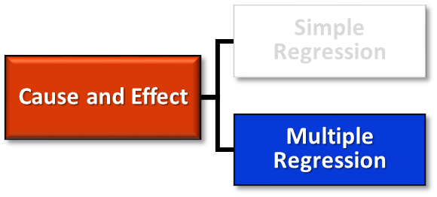
Cause and Effect – Multiple Linear Regression
  Multiple Linear Regression attempts to model the relationship between two or more independent variables and a dependent variable (demand) by fitting a linear equation to the observed data.
  Depending on the data and the number of independent variables, the mathematics involved can be complex.
  For example, the demand might be dependent on how much money is spent on advertising and promotion and also on the selling price charged for the product:
  If advertising is increased and the price is lowered, it is likely that demand will go up.
  If advertising is increased and the price is also increased, the impact on demand is not as obvious. The mathematics of multiple regression can help predict the impact on demand.

Slide 28

Fundamentals of Forecasting
These fundamentals of forecasting in business can be easily forgotten at times, to the detriment of the quality and accuracy of your forecasts.
Your forecast is most likely wrong
  The question you should be asking is “How wrong is the forecast?”
  Forecasting is difficult mainly because people know it is likely to be wrong and nobody likes to be publicly and visibly wrong.
  You must be willing to recognize and adapt to changing conditions — don’t fall in love with your forecast and ignore evidence that it may be wrong.
  Just be open to the first signs of change and be prepared to react quickly and decisively.

Slide 29
Fundamentals of Forecasting (continued)
Simple forecast methodologies trump complex ones
  There is danger in complexity. Complicated forecast methods often hide key assumptions built into the model.
  On the other hand, simple forecast methods are easy to understand, analyze and work out why it went wrong.
A correct forecast does not prove your forecast method is correct
  It could have been chance.
  If you only question your methods when there is a large variance in the data, you’ll miss all those times your forecast was just lucky.

Slide 30
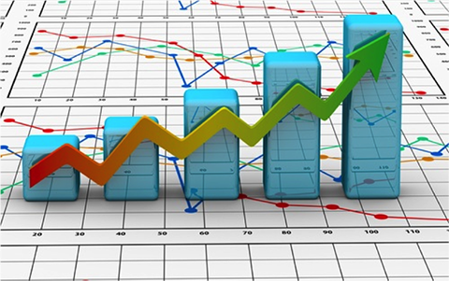
Fundamentals of Forecasting (continued)
If you don’t use the data regularly, trust it less when forecasting
  When information is not regularly used, errors often remain undetected.
  Regular use of data helps identify mistakes and smooths out inconsistencies over time.
All trends will eventually end (that’s why they’re called trends)
  Many factors will affect the pattern you’re trying to forecast.
  It doesn’t matter how accurately you predict the trend, in the future the variables will change and the forecast will be wrong.

Slide 31
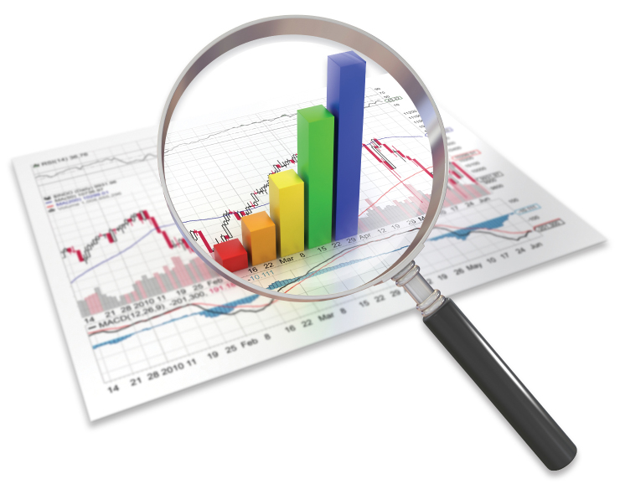
Fundamentals of Forecasting (continued)
It’s hard to eliminate bias, so most forecasts are biased
  When you have to make a range of assumptions (which factors to include, how strongly to weight them etc.), it’s likely that you will be adding some bias to the forecast.
Technology is not the solution to better forecasting
  Robust forecasting comes from sound logic in your methodology.
  Create an appropriate strategy and then use technology to make it more successful.
  Technology is not the answer; it’s the tool to make it better.

Slide 32
Forecast Error
Since forecasts are almost always inaccurate, companies need to track the forecast against actual demand and measure the size and type of the forecast error.
The size of the forecast error can be measured in units or percentages.
Error measurement plays a critical role in tracking forecast accuracy, monitoring for exceptions, and benchmarking the forecasting process.
Interpretation of these statistics can be tricky, particularly when working with low-volume data or when trying to assess accuracy across multiple items.

Slide 33
Forecast Error – Calculations and Examples
Forecast Error is the difference between the actual demand and the forecast demand. The error can be quantified as an absolute value or as a percentage.
    Actual Demand = 95 units
    Forecast Demand = 110 units
    Forecast Error Value = -15 units
    Forecast Error % = 15.8%
    Actual Demand = 125 units
    Forecast Demand = 110 units
    Forecast Error Value = 15 units
    Forecast Error % = 12.0%
Forecast Error Value = A – F
Forecast Error % = ((A – F) / A) x 100
Where:
A = Actual demand
F = Forecast demand

Slide 34
Measures of Forecasting Accuracy - MAD
Mean Absolute Deviation (MAD) measures the size of the forecast error in units. It is calculated as the average of the unsigned, i.e., absolute, errors over a specified period of time.
  Absolute errors for a series of time periods are added and then divided by the number of time periods. The resulting value is the MAD measure of forecast inaccuracy.
  Whether the forecast is over or under the actual demand is irrelevant; only the magnitude of the deviation matters in the MAD calculation.
          MAD = ∑(|A – F|) / n
            Where:
            A = Actual demand
            F = Forecast demand
            n = Number of time periods

Slide 35
Mean Absolute Deviation (MAD) - Example
Calculate the absolute deviation for each period and then average
Actual Demand | Forecast Demand | Deviation (i.e., Forecast Error) | Absolute Deviation
800 | 720 | 800 - 720 = 80 | 80
900 | 770 | 900 - 770 = 130 | 130
700 | 837 | 700 - 837 = -137 | 137
Sum of Absolute Deviations = 80 + 130 + 137 = 347
MAD = 347/3 = 115.7

Slide 36
Measures of Forecasting Accuracy - MAPE
Mean Absolute Percent Error (MAPE) measures the size of the error in percentage terms. It is calculated as the average of the unsigned percentage error.
  Many companies use the MAPE as it is easier for most people to understand forecast error and forecast accuracy in percentage terms rather than in actual units.
  MAPE is a useful variant of the MAD calculation because it shows the ratio, or percentage, of the absolute errors to the actual demand for a given number of periods.
MAPE = ∑ ((|A – F|)/ A) / n (expressed as a percentage)
  Where:
  A = Actual demand
  F = Forecast demand
  n = Number of time periods

Slide 37
Forecast Bias
  Forecast Bias is a consistent deviation from the mean in one direction; either high or low.
  In other words, bias exists when the demand is consistently over- or under-forecast. A good forecast is not biased.
  In the formula above, if the sum of the forecast error is not zero, there is bias in the forecast.
  A negative result shows that actual demand was consistently less than the forecast
  A positive result shows that actual demand was greater than forecast demand
  A forecast process with bias will eventually create significant problems in the supply chain if left unchecked. Good supply chain planners are aware of these biases. A best practice is to measure for forecast bias routinely and then make corrections accordingly.
        ∑ Forecast Error = ∑ Actual Demand – ∑ Forecast Demand

Slide 38
Running Sum of Forecast Errors (RSFE)
Running Sum of Forecast Errors (RSFE) provides a measure of forecast bias. RSFE indicates the tendency of a forecast to be consistently higher or lower than actual demand.
  A positive RSFE indicates that the forecasts were generally too low, underestimating the demand.
    In this situation, stock-outs are likely to occur as companies are unable to meet customers’ actual demand.
  A negative RSFE indicates that the forecasts were generally too high, overestimating demand.
    In this situation, excess inventory and higher carrying costs are likely to occur.
RSFE = ∑ e_{t}
  Where:
  e_{t} = forecast error for period t

Slide 39
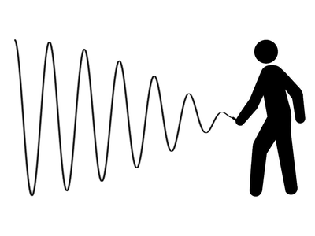
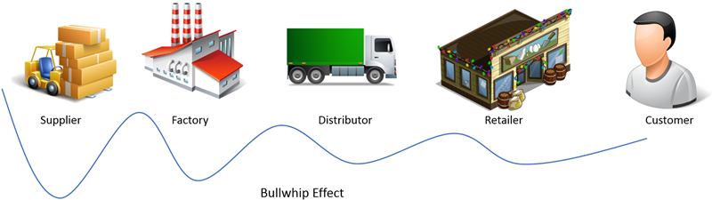
The Bullwhip Effect
  Because customer demand is not perfectly stable, businesses must forecast demand in order to properly position inventory and other resources.
  Forecasts are based on statistics, and they are rarely 100% accurate, therefore, companies often carry an inventory buffer called safety stock.
  Moving from the end-consumer(s) backward across the supply chain to raw material supplier(s), each supply chain participant is farther removed from the end demand and may have less information about what is happening with demand, creating a greater need to maintain higher levels of safety stock.
  In the absence of any other information or visibility, individual supply chain participants are second-guessing what is happening with ordering patterns, and potentially over-reacting, creating the bullwhip effect.
  In periods of rising demand, down-stream participants increase orders.
  In periods of falling demand, orders decrease or stop, and inventory accumulates.

Slide 40
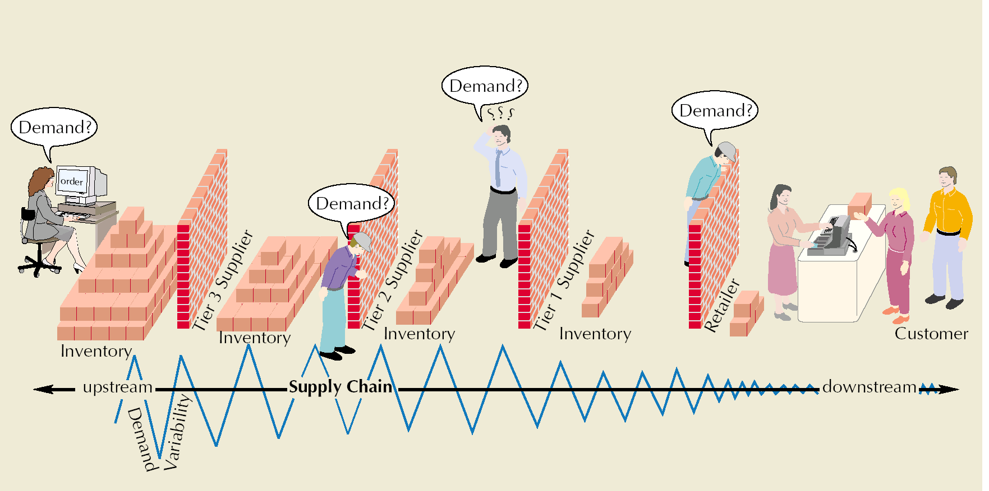
The Bullwhip Effect (continued)
When a small demand ripple in the market place is felt by the retailer at the end of the supply chain, the retailer will then start adjusting their orders to the wholesalers, and the wholesaler in turn will adjust its orders to the distributor, the distributor to the factory, and so on back up the supply chain.
When the new demand reaches the material or components supplier at the other end of the supply chain, the magnitude of fluctuation becomes unrecognizable.
An overreaction due to uncertainty occurs throughout the entire supply chain.

Slide 41
How can the Bullwhip Effect be Alleviated?
There is no single remedy, but there are some actions that supply chain participants can take collectively:
Collaboration: Sharing information through the use of electronic data interchange (EDI), point of sale (POS) data, and web-based systems can facilitate collaboration.
Synchronizing the supply chain: Supply chain participants coordinate planning and inventory management to minimize the need for reactionary corrections.
Reducing inventory: Through the use of just in time (JIT), vendor managed inventory (VMI), and quick response (QR), all of which will be discussed later in this course.
If the various participants work together to get closer to customers through collaborative planning, forecasting, and replenishment (CPFR), then the bullwhip effect can be greatly reduced.

Slide 42
Collaborative Planning, Forecasting, & Replenishment
  Collaborative Planning, Forecasting, and Replenishment (CPFR) is a business practice that combines the intelligence of multiple trading partners who share their plans, forecasts, and delivery schedules with one another in an effort to ensure a smooth flow of goods and services across a supply chain.
  CPFR can significantly reduce the Bullwhip Effect and provide a plethora of benefits including:
  Better customer service
  Lower inventory costs
  Improved quality
  Reduced cycle time
  Better production methods
Reducing the Bullwhip Effect means the reduction of safety stocks (and associated costs) within and across the trading partners in a supply chain.

